Slide 1
HOSPITAL OPERATIONS & PATIENT ANALYTICS DASHBOARD
MedTrack_DV
An interactive Tableau dashboard suite that transforms hospital operational data into measurable, decision-ready insight
9,216 Patient Records · 41 Analytical Fields · 12 Operational KPIs · 4 Integrated Dashboards
Presented by Abinaya Vijay
Under the Guidance of Our Mentor — Pathina Likhita
Infosys Internship Program · Group 2 Final Review

Slide 2
ROADMAP
Agenda
MedTrack_DV
Hospital Operations & Patient Analytics
Structure of today's presentation
1
Problem Statement
4
Tech Stack
7
Key Insights & Impact
Why hospital operations analytics matters
Tools and technologies used
What the data tells us
2
Proposed Solution
5
Dataset & KPIs
8
Future Scope
The MedTrack_DV dashboard suite
9,216 records engineered into 12 KPIs
Where the project goes next
3
Methodology
6
Results — Dashboard Walkthrough
Nine-stage end-to-end workflow
Four integrated Tableau dashboards
MedTrack_DV — Hospital Operations & Patient Analytics Dashboard • Group 2
2

Slide 3
THE CHALLENGE
Problem Statement
MedTrack_DV
Hospital Operations & Patient Analytics
Hospitals are data-rich but insight-poor
Context & Challenge
Fragmented Data
No Real-Time Visibility
Healthcare organizations generate large volumes of patient and operational data every day — yet this data sits scattered across admission logs, department registers and bed-management sheets.
Without an integrated analytical solution, administrators lack the evidence to answer basic operational questions:
How long do patients actually wait?
Which departments are overloaded?
Are beds being utilized efficiently?
Where do readmissions originate?
Admissions, discharges, beds and outcomes live in disconnected sources with no single operational view
Occupancy and patient flow are reviewed manually — often too late to act upon
Unmanaged Waiting Times
Unmeasured Performance
29.8% of patients wait over 45 minutes with no systematic tracking of bottlenecks
Departments cannot be compared on efficiency, LOS or readmissions — so little improves
OBJECTIVE
Design and implement an integrated Tableau dashboard suite that consolidates fragmented hospital data into twelve measurable KPIs — enabling administrators to monitor patient flow, evaluate departmental performance and optimize resource utilization with confidence.
MedTrack_DV — Hospital Operations & Patient Analytics Dashboard • Group 2
3

Slide 4
MEDTRACK_DV
Proposed Solution
MedTrack_DV
Hospital Operations & Patient Analytics
One unified Tableau workbook — four interconnected dashboards
MedTrack_DV.twb
34 Worksheets · 4 Dashboards
Every dashboard built worksheet-by-worksheet in one MedTrack_DV workbook — KPI cards, trends and comparisons on a single screen
1
Hospital Overview
5 KPI cards · 6 charts — admissions, occupancy, readmission, department & age mix, LOS
21 Interactive Filter Cards
2
Patient Flow
Admission month, day, shift, status, department, gender, race and age group — each filter updates every chart on its dashboard
4 KPI cards · 6 charts — admissions trend, status, LOS by department, flow by hour, shifts
Cross-Dashboard Navigation
3
Department Analytics
One-click movement between the four views — Overview to Flow to Departments to Resources
5 KPI cards · 6 charts — admissions, wait time, readmission, performance & efficiency by department
4
Resource Utilization
Consistent KPI Logic
5 KPI cards · 6 charts — bed occupancy, patient volume, utilization trend & capacity
12 operational KPIs computed from the same enriched dataset — overview cards, department bars and utilization charts always agree
OUTCOME
A single, trusted source of operational truth — supporting faster triage decisions, balanced departmental workloads and evidence-based capacity planning for administrators and policymakers.
MedTrack_DV — Hospital Operations & Patient Analytics Dashboard • Group 2
4

Slide 5
HOW WE BUILT IT
Methodology
MedTrack_DV
Hospital Operations & Patient Analytics
Nine-stage end-to-end analytics workflow
01
Data Collection
02
Data Cleaning
03
Transformation
Hospital & patient admission datasets integrated
Duplicates removed, missing data handled
Departments standardized, indicators normalized
04
KPI Engineering
05
Tableau Preparation
06
Dashboard Development
12 operational KPIs engineered into the dataset
Tableau-ready analytical dataset
4 dashboards built worksheet by worksheet
07
Integration
08
Testing & Validation
09
Documentation
Global filters, navigation & parameter actions
KPI accuracy > 95%, interactions QA'd
Full delivery package & repository
M1 · Data (W1–2)
M2 · KPIs (W3–4)
M3 · Dashboards (W5–6)
M4 · Delivery (W7–8)
MedTrack_DV — Hospital Operations & Patient Analytics Dashboard • Group 2
5

Slide 6
TECH STACK
Technology Stack
MedTrack_DV
Hospital Operations & Patient Analytics
The tools behind MedTrack_DV
Python
Tableau Desktop
Data Collection & Processing
Visualization & Dashboards
▪ data_collection.py — — integrates raw hospital datasets
▪ Pandas · NumPy — — cleaning & transformation
▪ generate_hospital_kpis.py — — KPI engineering
▪ 4 dashboards — — 30+ linked worksheets
▪ Calculated fields — — Total Admissions, Avg LOS
▪ Tableau Public — — optional online publishing
Dashboard Integration
GitHub & Markdown
Interactivity Layer
Documentation & Delivery
▪ Filters — — department, date, status, demographics
▪ Parameters & Actions — — cross-worksheet interactivity
▪ Navigation — — one-click dashboard switching
▪ Documentation — — 5 PDF deliverables, version-controlled
▪ Git repository — — full project delivery
▪ Modular repo — — scripts / data / dashboard / docs
MedTrack_DV — Hospital Operations & Patient Analytics Dashboard • Group 2
6

Slide 7
DATA FOUNDATION
Dataset & KPI Engineering
MedTrack_DV
Hospital Operations & Patient Analytics
One enriched dataset — twelve operational KPIs
Enriched Patient Flow Dataset
9,216
9,216
2.7 d
cleaned_healthcare_patient_flow_data_enriched.csv
Total Patients
Total Admissions
Avg Length of Stay
9,216
patient records (unique IDs)
COUNTD(patient_id)
COUNT(admission_flag)
AVG(LOS days)
41
analytical fields
77.4%
4.0%
35.3 min
7
departments — General Practice to Renal
Occupancy Rate
Readmission Rate
Avg Wait Time
AVG(bed_occupancy_rate)
AVG(is_readmitted)
AVG(patient_waittime)
19
months — Apr 2023 → Oct 2024
6
2,750
3.0 / 5
64.7
field families — patient, admission, department, flow, outcome, resource
Patients Waiting >45m
Satisfaction Score
Dept Efficiency
PREPARATION PIPELINE
29.8% of patients
AVG(satisfaction_score)
AVG(department_efficiency)
Collect
›
Integrate
›
Clean
›
Standardize
›
Enrich
+ Total Beds (200/record) · Occupied Beds (avg 155) · Bed Utilization Rate → 12 KPIs in total
Source: cleaned_healthcare_patient_flow_data_enriched.csv — 9,216 patient records, Apr 2023 – Oct 2024
MedTrack_DV — Hospital Operations & Patient Analytics Dashboard • Group 2
7

Slide 8
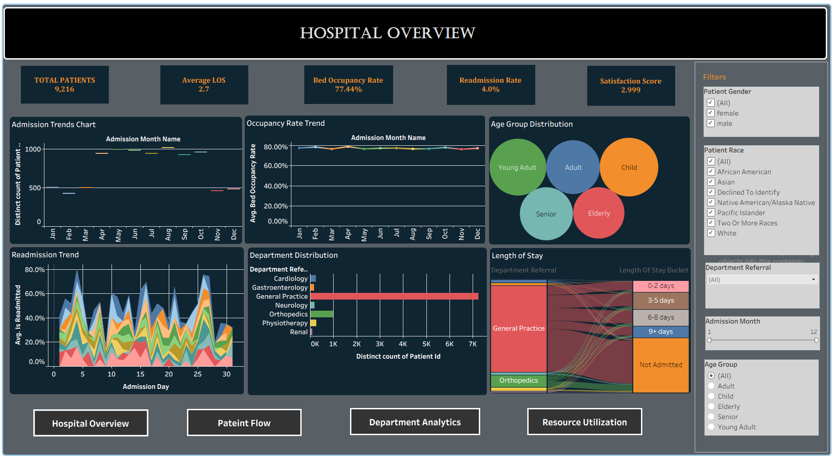
RESULTS · DASHBOARD 1 OF 4
Results — Hospital Overview
MedTrack_DV
Hospital Operations & Patient Analytics
Hospital performance KPIs, admissions, occupancy, readmission & satisfaction
8 / 16

Slide 9
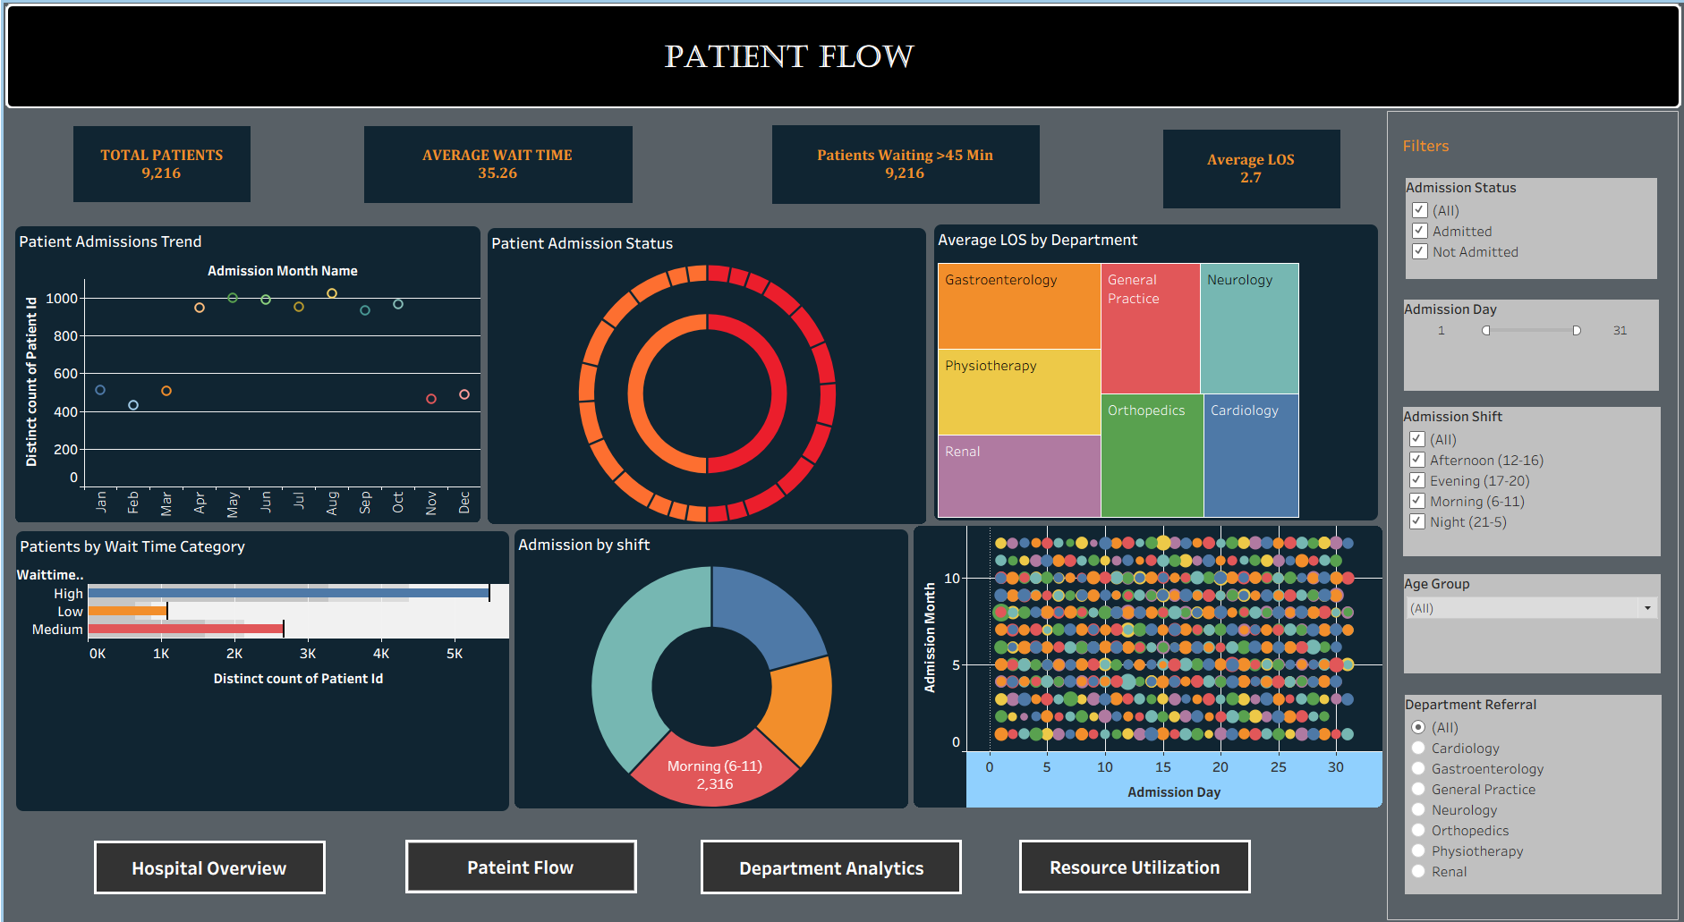
RESULTS · DASHBOARD 2 OF 4
Results — Patient Flow
MedTrack_DV
Hospital Operations & Patient Analytics
Admissions, waiting time, admission status, shifts & length of stay
9 / 16

Slide 10
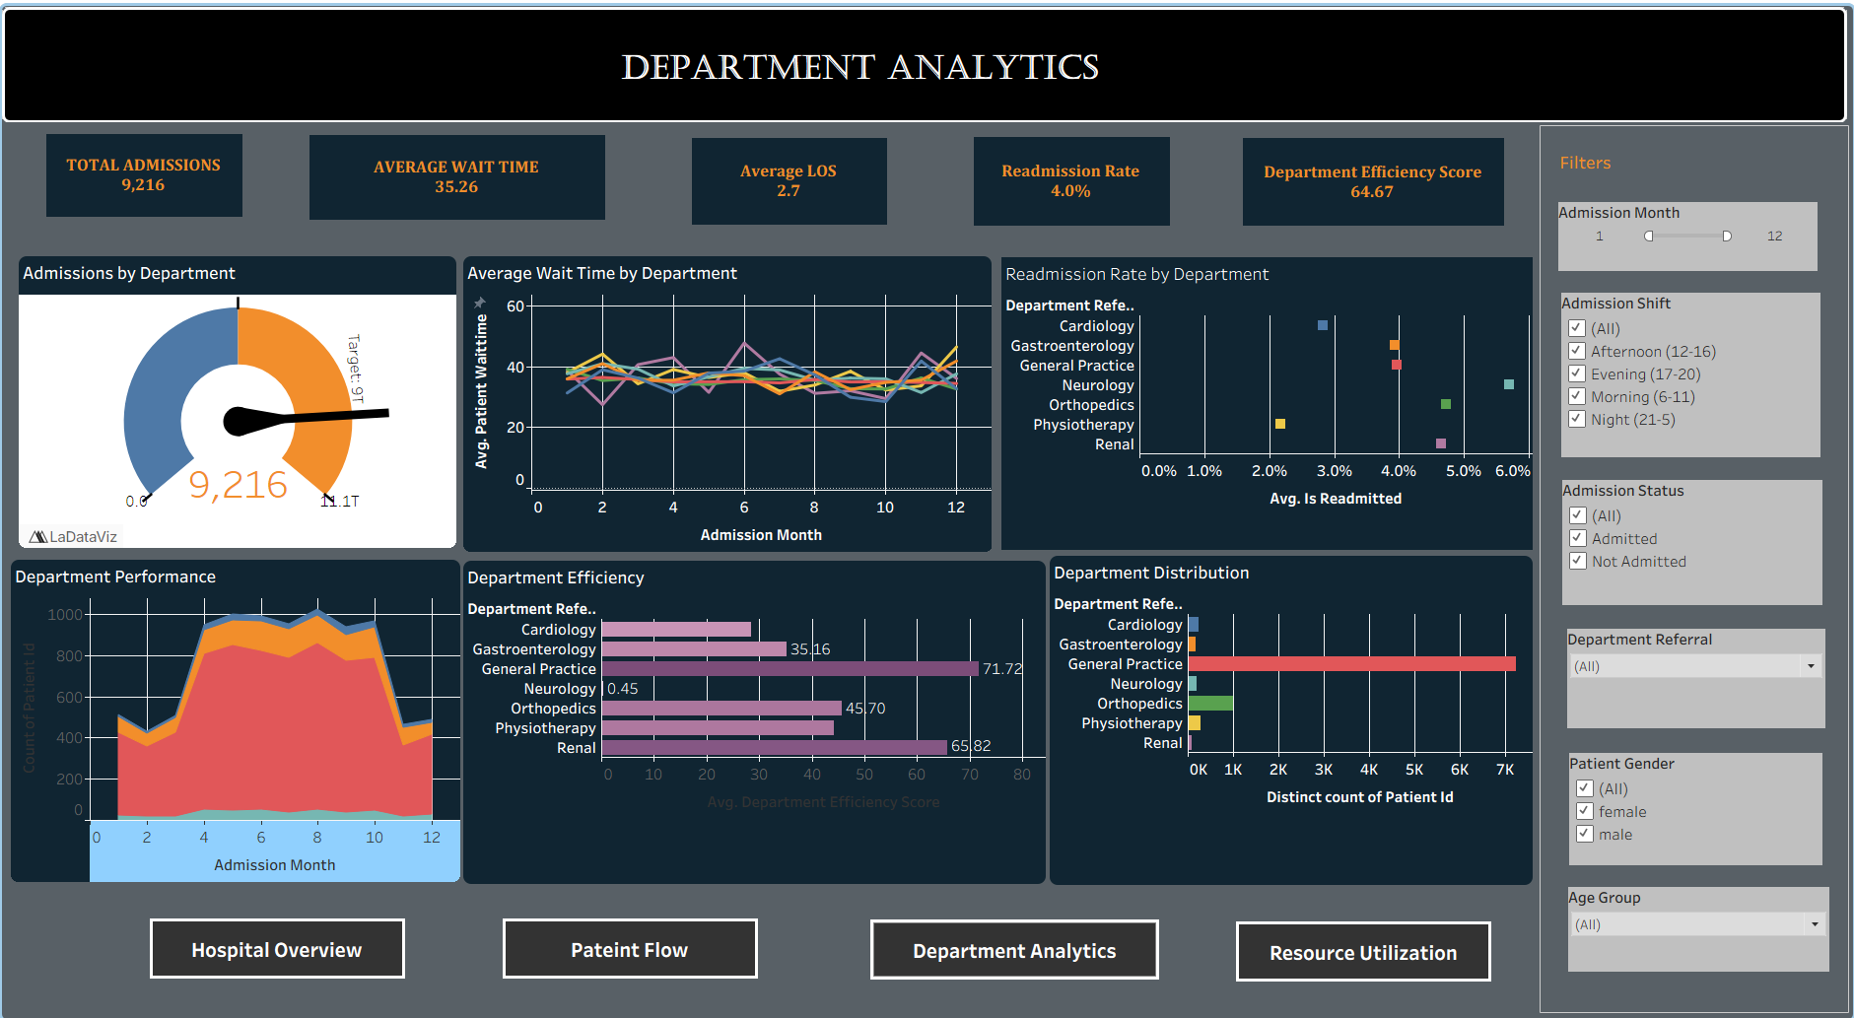
RESULTS · DASHBOARD 3 OF 4
Results — Department Analytics
MedTrack_DV
Hospital Operations & Patient Analytics
Operational performance across hospital departments
10 / 16

Slide 11
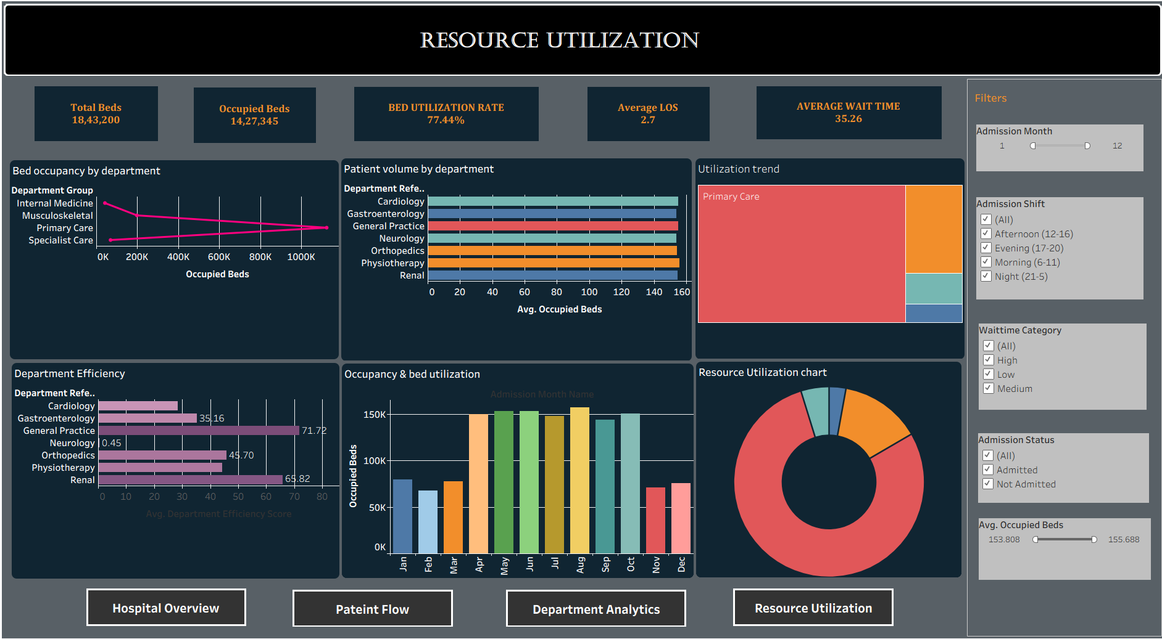
RESULTS · DASHBOARD 4 OF 4
Results — Resource Utilization
MedTrack_DV
Hospital Operations & Patient Analytics
Bed capacity, occupancy, bed utilization & department efficiency
11 / 16

Slide 12
IMPACT
Measurable Outcomes & Key Insights
MedTrack_DV
Hospital Operations & Patient Analytics
Findings from the data — and what we recommend
Waiting time is the #1 pressure point
Night shift carries the load
35.3-min average wait; 2,750 patients (29.8%) exceed 45 minutes. → Recommendation: re-deploy triage staffing toward peak-delay windows.
38% of all admissions occur overnight (21:00–05:00), peaking at 23:00. → Recommendation: align night staffing and bed-turnover with the night curve.
General Practice dominates volume
Occupancy is healthy but watchful
78.6% of patients (7,240 of 9,216) route through General Practice. → Recommendation: targeted GP triage moves the whole hospital's numbers.
77.4% average utilization; no month above the 85% pressure threshold. → Recommendation: protect headroom — improve flow before capital expansion.
Readmissions are well controlled
Stays are short and predictable
4.0% overall (369 patients); Neurology runs highest at 5.7%. → Recommendation: focused Neurology discharge-review pilot.
5.5-day average LOS for admitted patients; 79% stay 8 days or fewer. → Recommendation: standardize discharge-planning protocols.
Source: cleaned_healthcare_patient_flow_data_enriched.csv — 9,216 patient records, Apr 2023 – Oct 2024
MedTrack_DV — Hospital Operations & Patient Analytics Dashboard • Group 2
12

Slide 13
ROADMAP AHEAD
Future Scope
MedTrack_DV
Hospital Operations & Patient Analytics
Where MedTrack_DV goes next
Real-Time Data Pipeline
Predictive Analytics
Stream admissions into the dashboard live — from monthly batch files to hourly operational monitoring.
Forecast admissions, occupancy and LOS with machine learning; predict readmission risk per patient.
Alerts & Threshold Monitoring
Bed-Level & Ward-Level Views
Automatic alerts when occupancy crosses 85%, waits exceed targets or a department's readmissions spike.
Drill from hospital to ward to individual bed — real-time floor maps for capacity managers.
Multi-Hospital & Regional Rollout
Natural-Language Q&A
Benchmark departments across hospitals and regions on one shared KPI framework.
Ask the dashboard questions — 'which department had the longest waits in June?' — powered by NLP.
CONCLUSION
MedTrack_DV demonstrates that disciplined data engineering combined with purposeful visualization converts routine hospital records into actionable operational intelligence — a scalable foundation for hospital-wide analytics.
MedTrack_DV — Hospital Operations & Patient Analytics Dashboard • Group 2
13

Slide 14
MENTORSHIP
Guided by dedicated mentorship
Mentor
Pathina Likhita
Project Guide — MedTrack_DV, Hospital Operations & Patient Analytics Dashboard
Presented by
Abinaya Vijay
Group 2 — Hospital Operations & Patient Analytics Dashboard
Modules 1–8 delivered end-to-end: data collection → cleaning → KPI engineering → dashboards → documentation
Repository: Hospital-Operations-and-Patient-Analytics-Dashboard-Group-2

Slide 15
Thank You
MedTrack_DV — Hospital Operations & Patient Analytics Dashboard
Abinaya Vijay · Mentor: Pathina Likhita

